Slide 1
HTML TAGS
MCNDHS
Ms. Eng

Slide 2
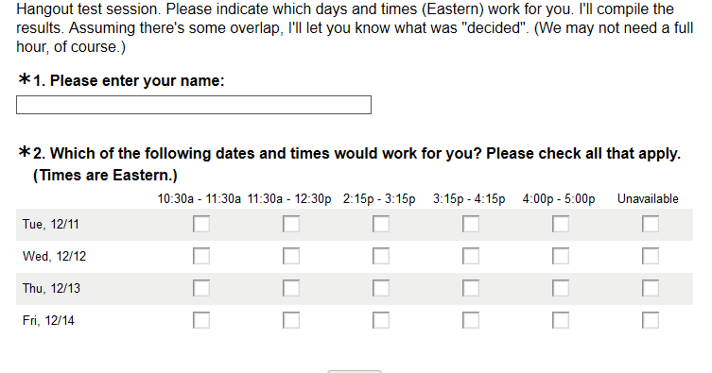
HAVE YOU EVER TAKEN A SURVEY?

Slide 3
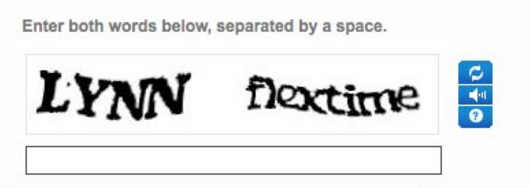
CAPCHA

Slide 4
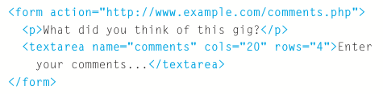
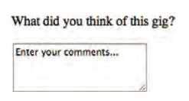
HTML TAG
design question:
Should the columns and rows stay the same size?

Slide 5
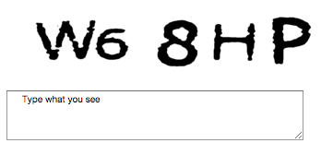
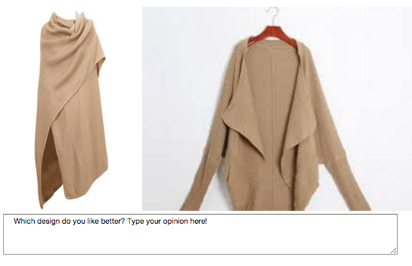
YOU TRY!

